Slide 1
WCO Capacity Building Committee III
February 27-29, 2012

Slide 2
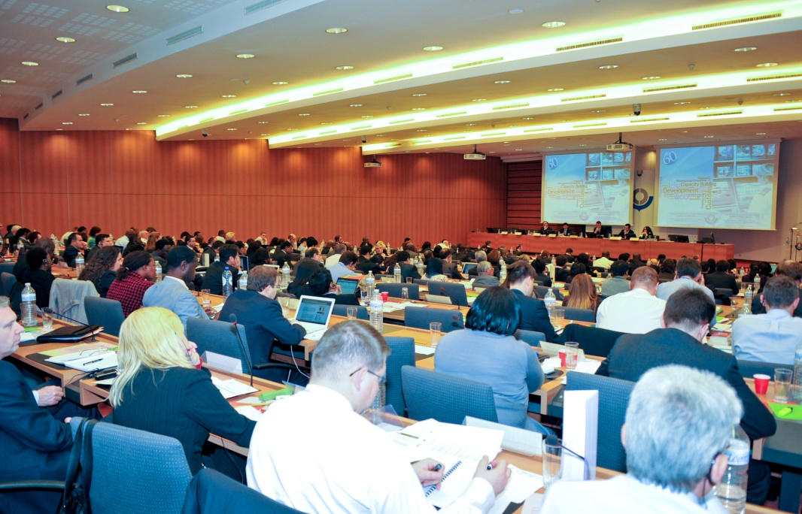
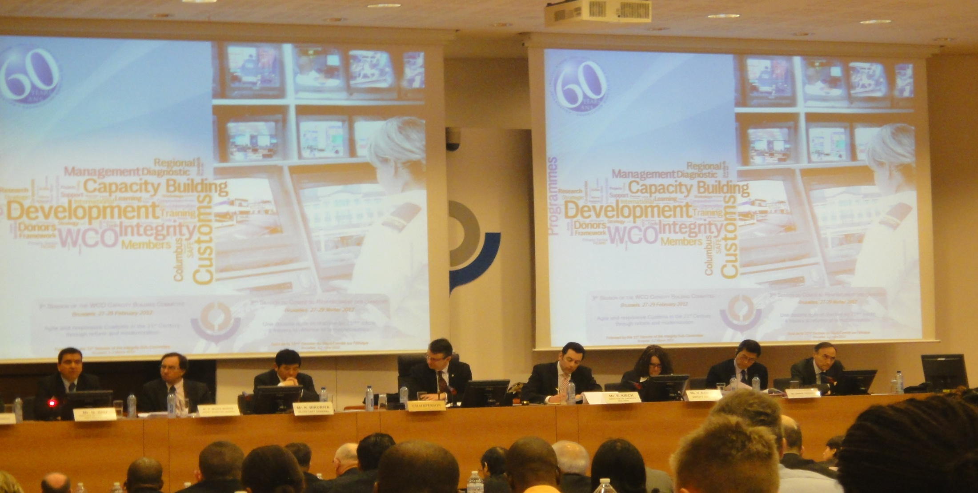
Capacity Building Committee III
27-29 February
2012

Slide 3



Capacity Building Committee III
People
Political Will
Partnerships
Customs in the 21st Century
No longer business as usual
3
Notes:
Third CBC meeting focused on the theme of an “Agile responsive customs in the 21st Century through reform and modernization”
Panel discussion lead by the DG of Brazilian customs on how to implement an organizational development process:
Participants reached agreement on the following:
Essential features for success in reforming and modernizing administrations include
effective governance,
solid strategic plan,
good project management,
effective communication,
dedicated team and enthusiasm!
Progress of ongoing work by the CB directorate, ROCB’s, RTC’s, donors and other partners was recognized; of note was the presentations made by Argentina and Mexico highlighting the importance and value of the three P’s in developing solid, effective programs

Slide 4

Phase 3 – Columbus Programme
Notes:
The Secretary General noted the success of the CBC thus far, including the roadmap: Customs Capacity Building in the 21st Century, the strengthening of donor coordination and systematic approach being taken to ensure needs based activities match appropriate partners.
Phase 1 of the Columbus Programme is focused on understanding the current
situation, and provides the starting point for Customs modernization. The WCO
Diagnostic Framework is the basis for mission experts to prepare and conduct the diagnostic mission and submit a report to the beneficiary Customs administration.
Phase 2 of the Columbus Programme is focused on planning, structuring and
implementing the reform and modernization priorities.
Phase 3 offers an opportunity for the WCO to assess progress and recommend adjustments to the ongoing modernization activities by way of a monitoring and evaluation process. It is in no way the end of the modernization process but rather an opportunity to pause and reflect on the progress achieved by the Member to better define future direction and priorities.
Kenya delivered an excellent presentation on its Phase 3 pilot project, highlighting the successes related to its implementation of modernization programms and increased revenue collection, staff training and retention levels, as well as significant reforms in IT and stakeholder engagement.
The pilots reaffirmed the 3P principle. A key lesson learned by the two administrations during their pilots was the value and need to share information and experiences with partners and stakeholders outside the Customs Community. The 3P‘s we speak of repeatedly remain relevant and critical – political will, people and partnerships.

Slide 5
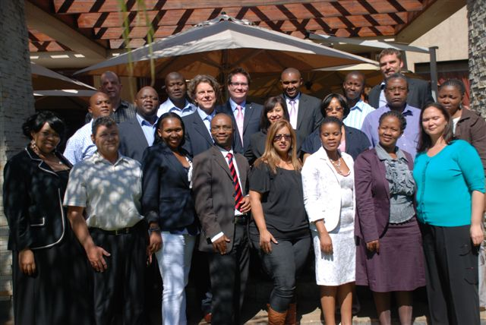
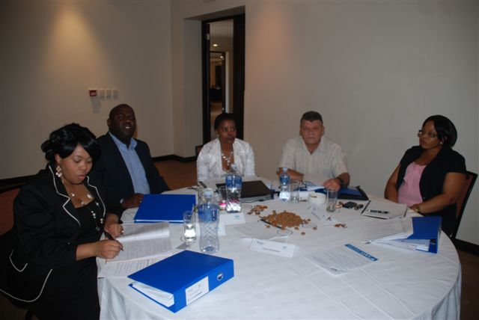
Leadership & Management Development
Inaugural Accreditation course delivered March 2012
Notes:
The overall objectives of the programme:
Contribute to creating organizations that can:
be more self-sufficient in their development,
better anticipate and respond effectively to changes in the environment, and
better meet the organizational objectives set by their respective governments;
In sponsoring nominees and having them participate in the LMD programme, it also will help to:
Identify and develop leaders who can set a vision for the future and guide organizations;
develop managers who understand the Customs environment, its challenges and emerging trends, and who can lead the
Leaders who can find innovative solutions and practice modern management;
provide opportunities for managers to build networks and relationships.
The CBC approved the:
Content and material of the programme
Maintenance of an informal Advisory Group open to all interested parties.

Slide 6
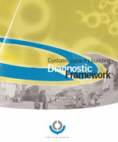
Diagnostic and Compendium
Diagnostic Framework and Compendium to be updated to reflect emerging trends and priorities
New chapter to be added to the Compendium on performance measurement.
Notes:
Building on the partnership theme and the necessity to be creative in finding new solutions to new and existing challenges, the CBC emphasized the need to refocus on leadership skills.
The inaugural LMD course helps provide that impetus to ensure future leaders do not rely on the philosophy of “that is how it has always been done” but instead, are innovators and problem-solvers.
Reflecting the need to stay current and relevant in its own approaches, the CBC has committed to updating the Compendium and framework to better align with emerging priorities;
As part of that exercise the Performance Measurement chapter of the Compendium has been endorsed. It contains definitions, models and examples, organization Performance Management Methods, designing Performance indicators, Service standards, annexes

Slide 7


Partnership
In
Customs
Academic
Research and
Development
7
Notes:
Need to develop PICARD 2020 strategy identified by CBC supported by:
Two pillars: research and customs professionalism
University Accreditation:
The WCO has also developed a formal recognition process for University Customs Curricula which enables Bachelor and Master Degrees to bear the WCO label if compliant with the Professional Standards. So far, five Universities have been awarded WCO recognition for their academic programmes, while a further two applications are in the review process.
Of note, for the Americas, is a project being undertaken by the US:
US Customs and Border Protection (CBP) has taken the initial steps for a project to develop Customs academic programmes at graduate and certificate level. According to its preliminary findings, so far no North American University appears to have provided a curriculum directed specifically towards Customs and Excise Studies. CBP intends to base its approach on a strategic partnership between Customs, the trade community and academic institutions, as well as on the WCO PICARD Professional Standards, in order to develop recognized curricula.

Slide 8
Delivery and Needs
Focus on CB delivery confirmed
Expressed CB needs
SP/OD
C2B
RKC
CBM
SW
Other Enf
HR
IPR
Integrity
ICT/DM
RM
PCA
Notes:
This slide is informative and valuable for two main reasons:
First, it illustrates the wide variety and scope of needs of member administrations;
Two, the diversity of needs implicitly demands that donors, members, partners and stakeholders in general, must prioritize if sustainable, measureable results are to be achieved.
In considering the various needs, it is clear that capacity building has had an impact on members. By targeting priority needs, members can address vital program areas in a logical and sustainable manner. For the Americas, it has been made clear through diagnostic missions, partnerships and stakeholder engagement sessions that AEO programs and Single Window initiatives rank high on the priority list.
Within the Americas, there has been significant work done in advancing those two areas of customs.
That is not to say the other areas are not important, but what is valuable and worth sharing is that Directors General can look at all the needs and feel confident that the WCO and its tools, and contributing countries/donors are working with members to address the needs of members and not imposing external solutions.

Slide 9
CBC III Highlights
People
Americas region a leader in promoting
South-South donor relations
Critical need for research and ongoing assistance
“Not business as usual”
Political Will
Partnerships
Notes:
Importance of customs to global trade and economic recovery of the international community.
Americas region a leader in promoting South-South donor relations.
Critical need for research and ongoing assistance.
“Not business as usual”

